Slide 1
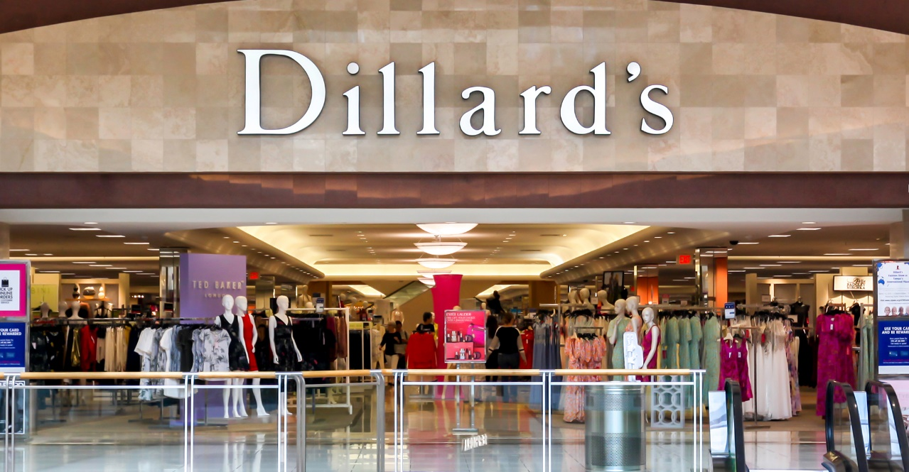
Optimizing Retail Strategy:
Enhanced Product Association Modeling
through Clustering & Market Basket Analysis
for Dillard’s
MLDS 400-Final Project
Authors: Daniel Wang, Mahi Shah, Tzuliang Huang, & Xinran Wang

Slide 2
Introduction
Methods
Data
K-prototype Clustering
Market Basket Analysis
Results
Clustering
MBA
ROI
Conclusion
Agenda

Slide 3

01
Introduction
MLDS 400-Final Project

Slide 4
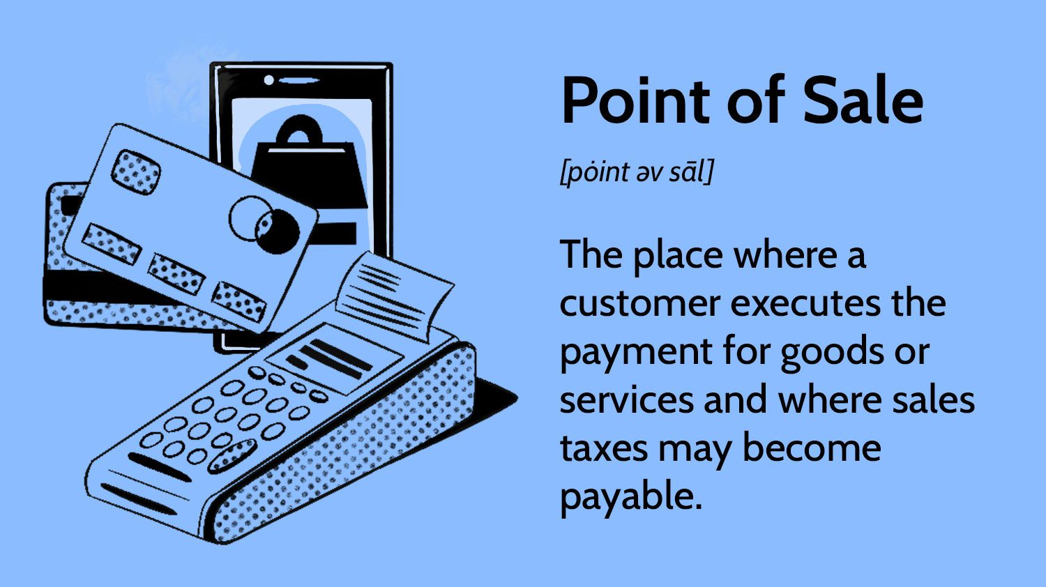
Objective:
Revolutionize Dillard’s retail strategy by employing advanced data analytics techniques
Source:
Comprehensive Point of Sale (POS) data
Goal:
Optimize product recommendation strategy:
Recommend products based on the association rules generated in this project
Introduction

Slide 5

02
Methods
MLDS 400-Final Project

Slide 6
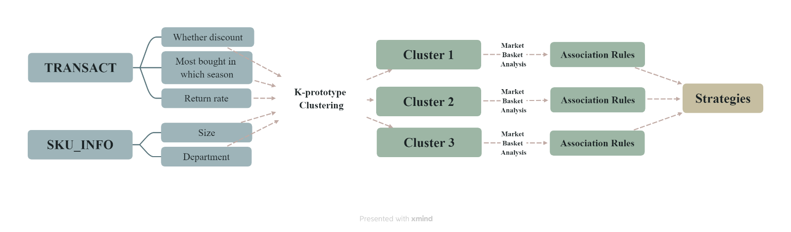
Central Framework
Two-step approach advantages:
1. reduce computational efforts 2. enhance the precision of our recommendations

Slide 7
Data: Database
SKUINFO
for product attributes
TRNSACT
for transactional histories
STRINFO
for store characteristics
SKSTINFO
for inventory records

Slide 8
Data Cleaning
SKUINFO:
Shifted column datas due to multiple values in COLOR and other columns
Use PACKSIZE as reference point for shifted column values
Examine NA and missing values
TRNSACT:
Removed duplication between Sprice and AMT
Correct data irregularity in ORGPRICE by imputing the 0s for corresponding SKU values

Slide 9
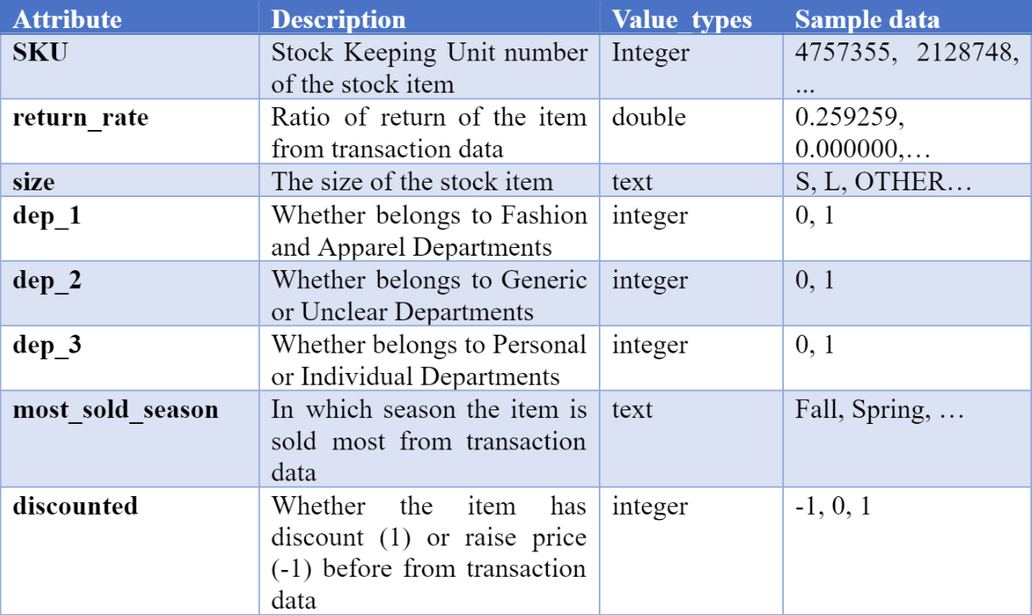
Data: Summary of five selected features

Slide 10
K-prototype clustering
Employ a dissimilarity measure that considers both numerical and categorical distances
The update step recalculates centroids by computing means for numerical features and modes for categorical ones
Through iterative refinement, the algorithm converges to stable cluster assignments
Key feature:
Combine the strengths of k-Means clustering and the k-Modes algorithm
Handle both numerical and categorical data

Slide 11
Market Basket Analysis
Study items that frequently bought together from the transaction data given,
Great for understanding customer preferences and purchasing behaviors.
In our project:
By applying market basket analysis for each cluster, we could find similar SKUs that consumers are more likely to purchase together, which are called ‘association rules’.

Slide 12

03
Results
MLDS 400-Final Project

Slide 13
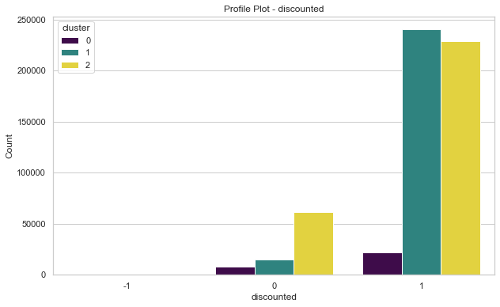
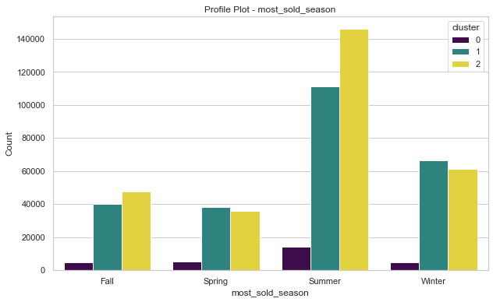
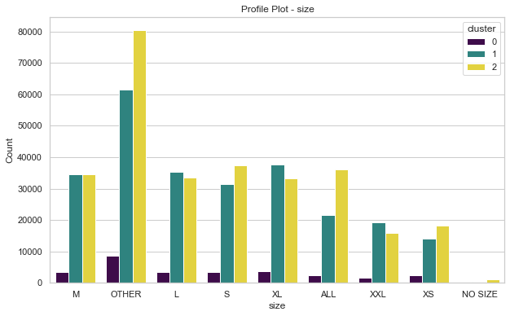
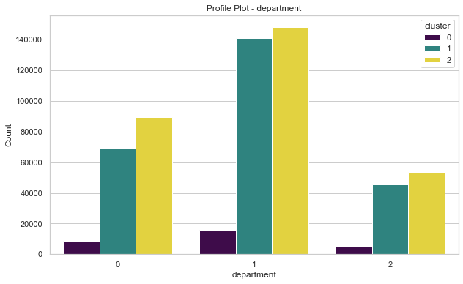
Clustering results

Slide 14
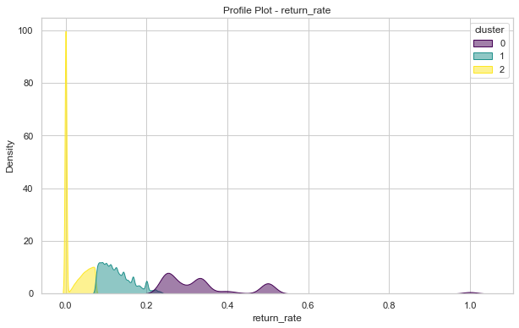
Clustering results
Distribution:
Cluster 2: 291,111 items
Cluster 1: 255,980 items
Cluster 0: 29,402 items
Distinct profiles of each cluster: laying the groundwork for informed decision-making

Slide 15
MBA results
In total 565 association rules Example Rule: A => B
looked into the combined pairs that show up at least 8% in all the transaction dataset
50% confidence: Only generate rules if there are more than 50% of transactions that have SKU B among the data that has SKU A. So we are quite confident about the rules since we can tell there is enough data showing the relationships.
Lift values bigger than 1: lift measures how much more often the antecedent and consequent occur together than expected if they were statistically independent. So it confirmed the reliability of the rules generated.

Slide 16
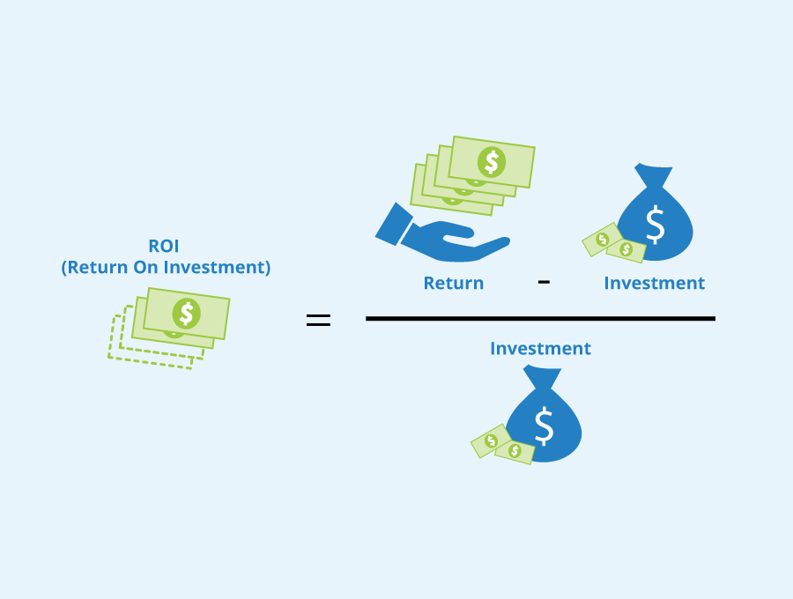
04
ROI
MLDS 400-Final Project

Slide 17
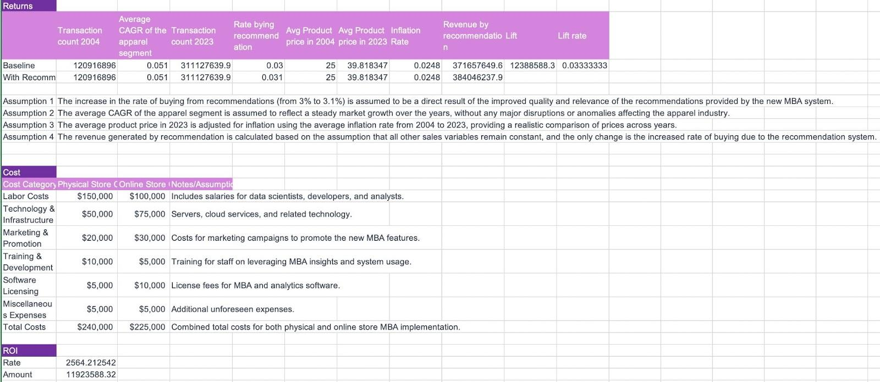
ROI Report
Increase in Dillard's purchase rate from 3% to 3.1%

Slide 18
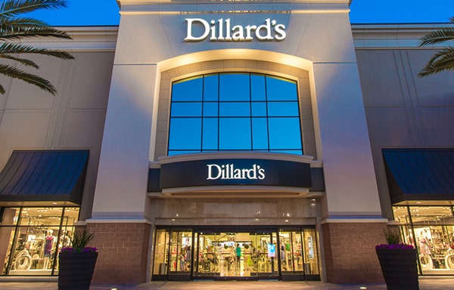
05
Conclusion
MLDS 400-Final Project

Slide 19

The approach, which grouped products based on essential features and then applied MBA for detailed product association rules, increased both computational efficiency and recommendation accuracy.
It enhanced the customer shopping experience by offering product recommendations.
It yielded a positive Return on Investment (ROI), demonstrating its economic viability.
CONCLUSION

Slide 20
Thank you!
MLDS 400-Final Project
Authors: Daniel Wang, Mahi Shah, Tzuliang Huang, & Xinran Wang

